Slide 1
Chapter 2
Number Systems, Operations, and Codes
(计数系统、运算和编码)
延 边 大 学 工 学 院
计 算 机 科 学 与 技 术 专 业
王 晓 丹

Slide 2
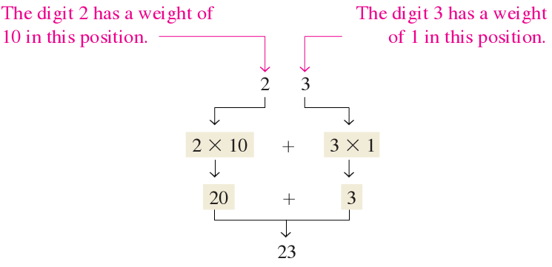
2.1: Decimal Numbers(十进制数)
1，2，3，4，5，6，7，8，9，0
weight: 权 （ex: 23）

Slide 3

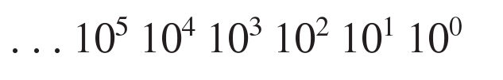
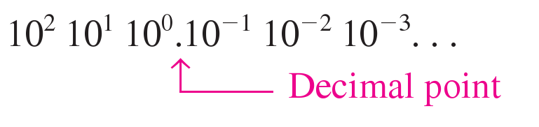
Decimal Numbers(十进制数)
The weights for whole number(整数的权)are
positive powers of ten that increase from
right to left, beginning with:

Slide 4
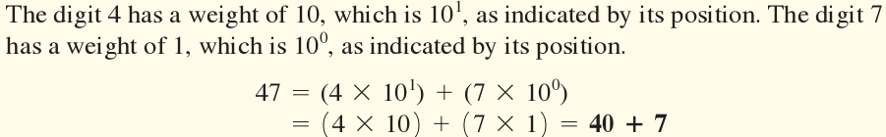
Express the decimal number 47 as a sum of
the values of each digit
(把十进制数47表示为各位数字值的求和)
Solution:

Slide 5

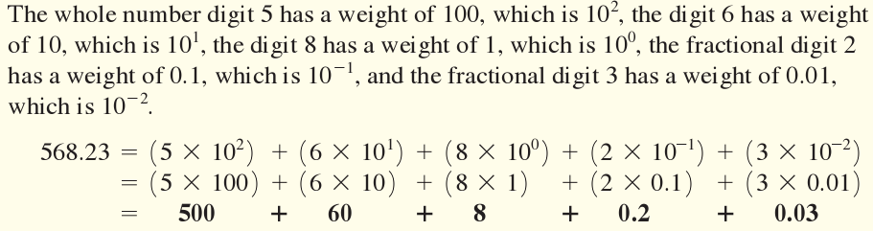
把十进制数568.23表示为各位数字值的求和

Slide 6
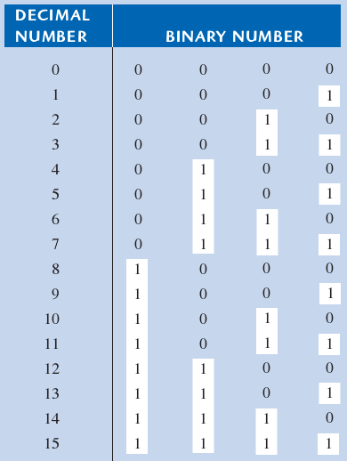
2.2 Binary Numbers(二进制数)
The two binary digits (bits) are: 1 and 0
The binary number system has a base of 2

Slide 7

Binary Numbers(二进制数)
Four bits are required to count from zero to
15. In general, with n bits you can count up to
a number equal to

Slide 8




Binary Numbers(二进制数)

Slide 9
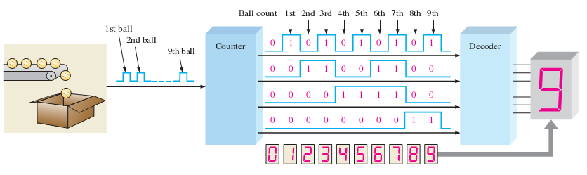
An application (Binary Counting)

Slide 10

The Weighting Structure of Binary Numbers
A binary number is a weighted number(权数)
The right-most bit is the LSB(Least Significant
Bit), and has a weight of
The weights increase from right to left by a
power of two for each bit
The left-most bit is the MSB(Most Significant
Bit)

Slide 11
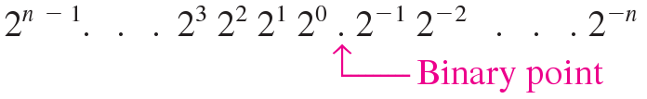
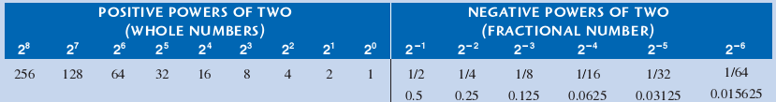
The Weighting Structure of Binary Numbers
The weight structure of a binary number is:
(二进制数的加权结构)

Slide 12
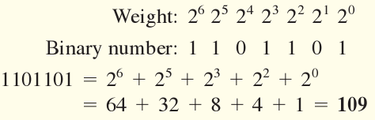
Binary-to-Decimal Conversion
Convert the binary whole number 1101101 to
decimal
（把二进制整数1101101转换为十进制数）

Slide 13
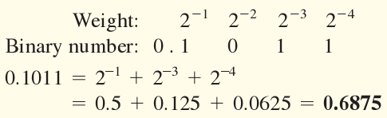
Binary-to-Decimal Conversion
Convert the fractional binary number 0.1011
to decimal
（把二进制小数0.1011转换为十进制数）

Slide 14
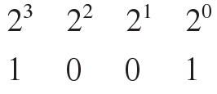

2.3 Decimal-to-Binary Conversion
2.3.1 Sum-of-Weights Method（权和的方法）

Slide 15

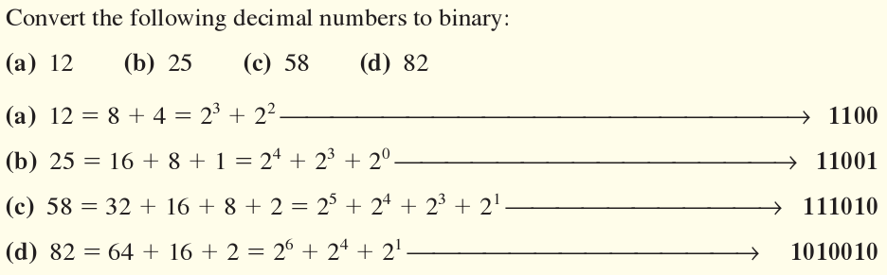

Slide 16
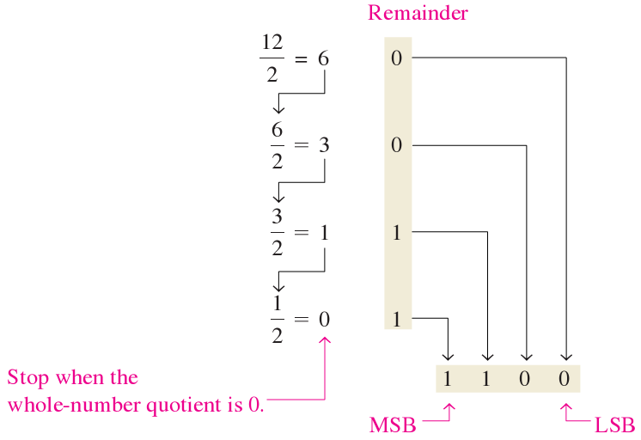
2.3 Decimal-to-Binary Conversion
2.3.2 Repeated Division-by-2 Method
（重复除以2的方法）

Slide 17

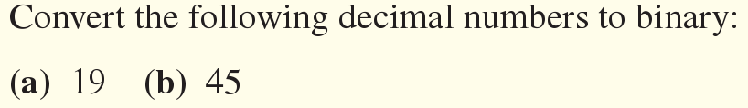
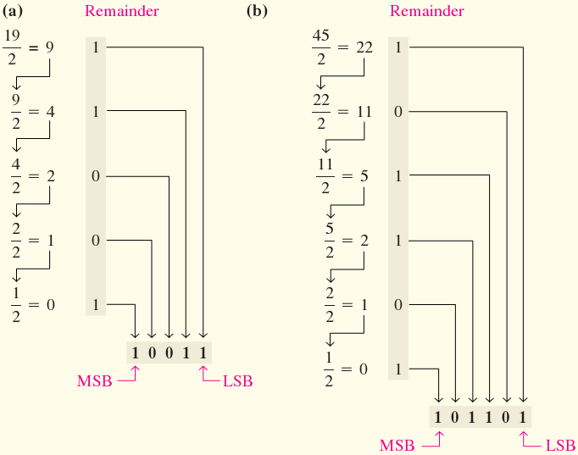

Slide 18
2.3 Decimal-to-Binary Conversion
2.3.3 Converting Decimal Fractions to binary
（将十进制小数转换为二进制）
Sum-of-weights(权的和)：

Slide 19
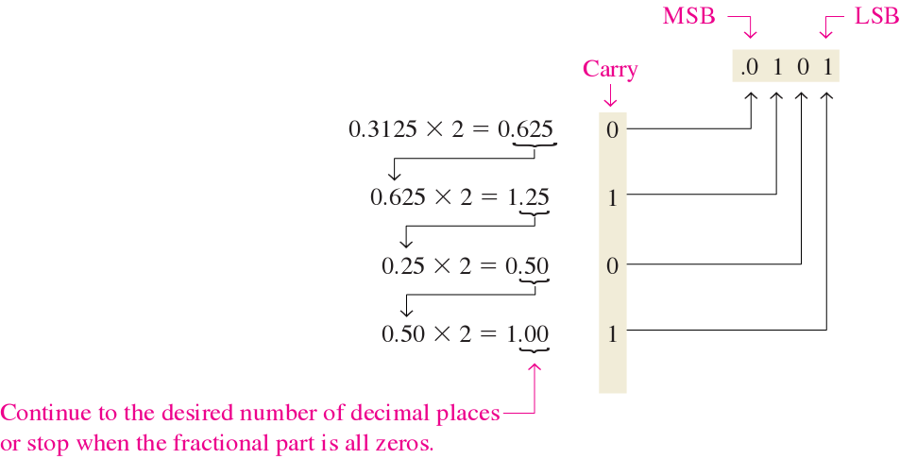
2.3 Decimal-to-Binary Conversion
Repeated Multiplication by 2 (重复乘以2)：
当整数商为0时结束

Slide 20
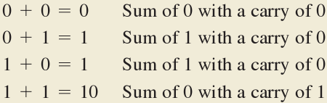
2.4 Binary Arithmetic(二进制算数)
2.4.1 Binary Addition(二进制加法)

Slide 21
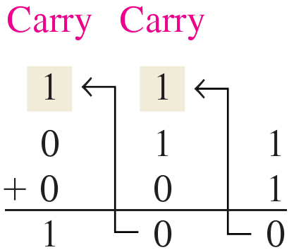
2.4 Binary Arithmetic(二进制算数)
2.4.1 Binary Addition(二进制加法)

Slide 22
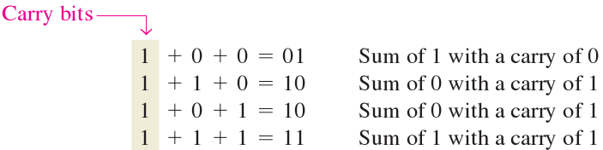
2.4 Binary Arithmetic(二进制算数)
2.4.1 Binary Addition(二进制加法)

Slide 23

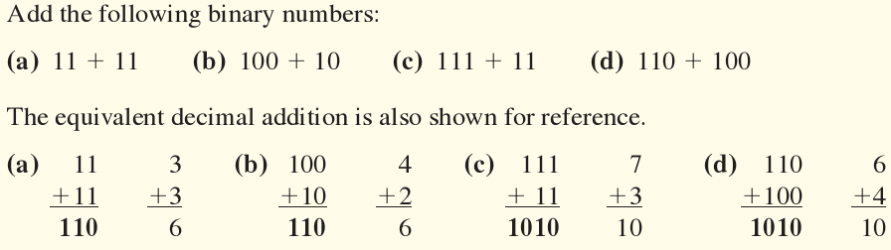

Slide 24
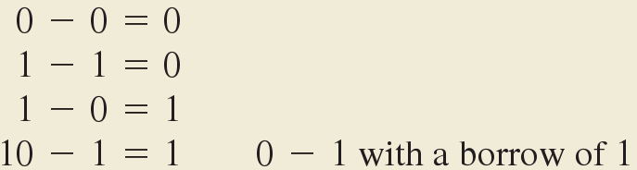
2.4 Binary Arithmetic(二进制算数)
2.4.2 Binary Subtraction(二进制减法)

Slide 25
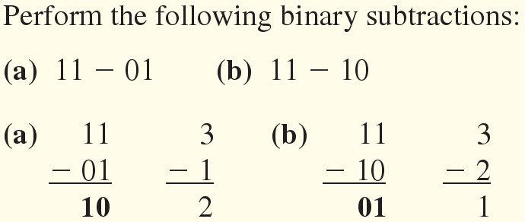
2.4 Binary Arithmetic(二进制算数)
2.4.2 Binary Subtraction(二进制减法)

Slide 26

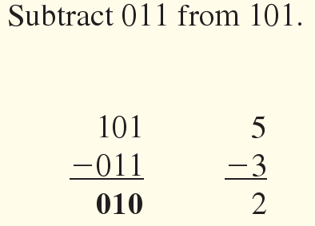

Slide 27
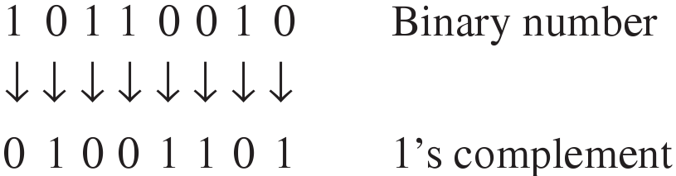
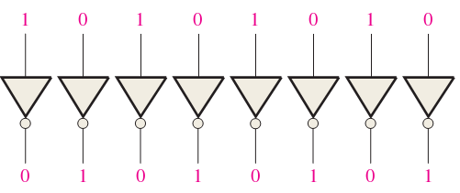
2.5.1 Finding the 1`s Complement
(二进制数的反码)

Slide 28
2.5.2 Finding the 2`s Complement
(二进制数的补码)
The 2`s complement of a binary number is
found by adding 1 to the LSB of the 1`s com-
plement
补码 = 反码 + 1

Slide 29

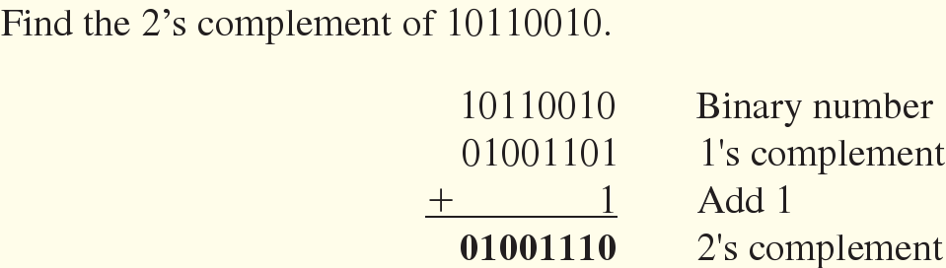

Slide 30
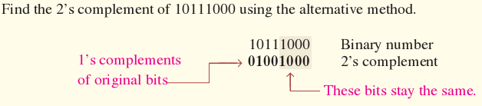

Slide 31
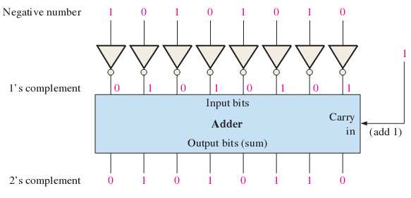

Slide 32
2.6 Signed Numbers(带符号数)
2.6.1 The Sign bit(符号位)
The left-most bit in a signed binary number is
the sign bit, Which tells you whether the
number is positive or negative
0 sign bit indicates a positive number,
1 sign bit indicates a negative number

Slide 33

2.6 Signed Numbers(带符号数)
2.6.2 Sign-Magnitude Form (符号数值的形式)

Slide 34
2.6 Signed Numbers(带符号数)
2.6.3 1`s Complement Form (反码形式)
ex: Using 8 bits, the decimal number -25 is
expressed as the 1`s complement of +25
(00011001) as 11100110
- 在反码形式中， 负数就是其相应正数的反码

Slide 35
2.6 Signed Numbers(带符号数)
2.6.4 2`s Complement Form (补码形式)
ex: Using 8 bits, the decimal number -25 is
expressed as the 2`s complement of +25
(00011001) as 11100111
- 在补码形式中， 负数就是其相应正数的补码

Slide 36

2.6 Signed Numbers(带符号数)
2.6.6 Range of Signed Integer Numbers That
Can be Represented
(带符号整数的表示范围)
- 二进制数的数值范围取决于数的位数

Slide 37
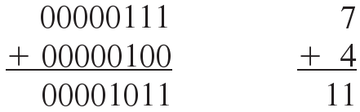
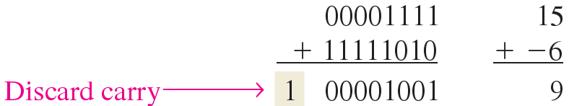
2.7 Arithmetic operations with Signed Numbers
(带符号数的算术运算)
2.7.1 Addition (加法)
两个数都是正的：
正数的数值大于负数的数值：
放弃

Slide 38
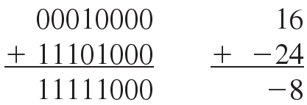
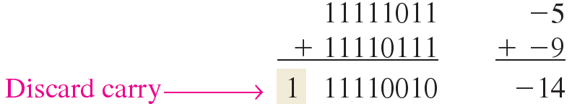
负数的数值大于正数的数值：
两个数都是负的：

Slide 39
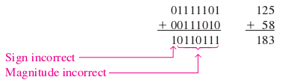
Overflow Condition（溢出条件）：
- 183数的大小需要8位
两个数都是负的：
符号不正确
大小不正确

Slide 40
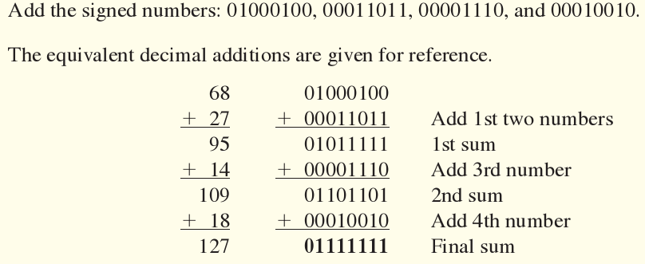

Slide 41
2.7.2 Subtraction(减法)
减法是将减数符号改变后的加法
要将两个带符号数相减，取减数的补码然后相加。
舍去最后的任何进位

Slide 42


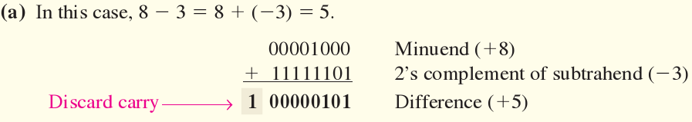

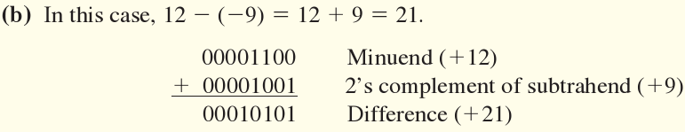

Slide 43

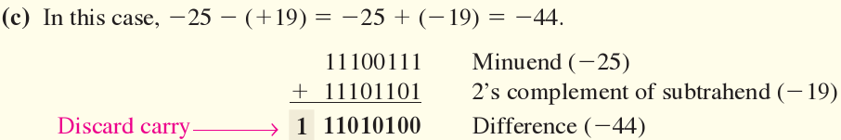

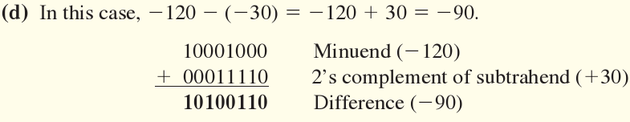

Slide 44
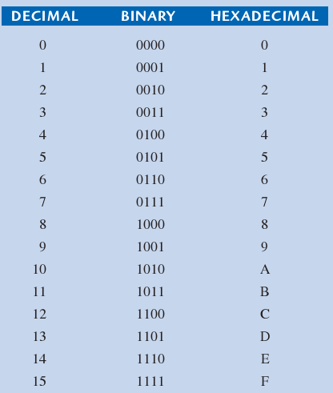
2.8 Hexadecimal Numbers(十六进制)

Slide 45
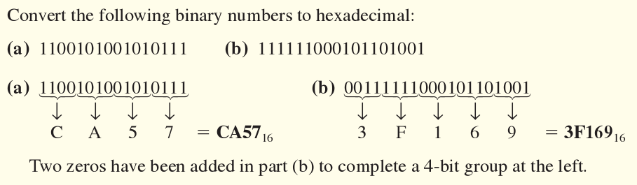

Slide 46
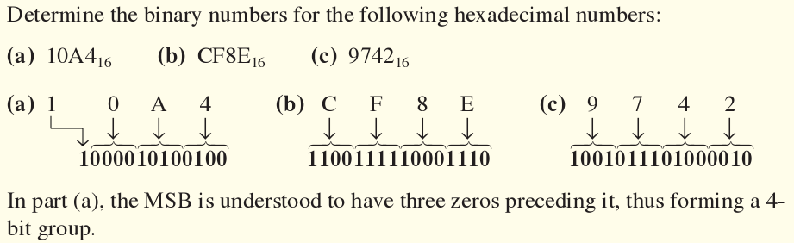

Slide 47
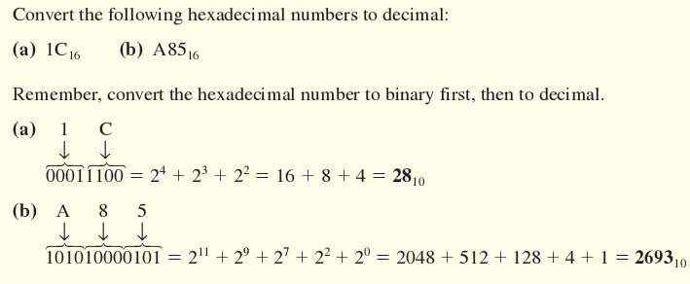

Slide 48
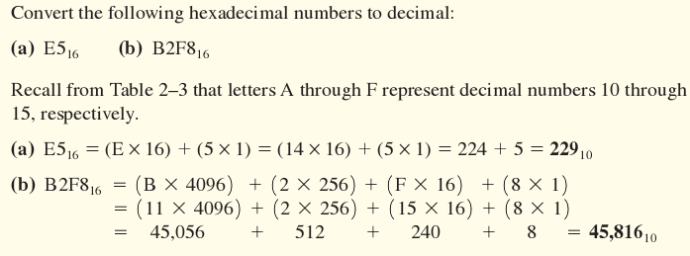

Slide 49
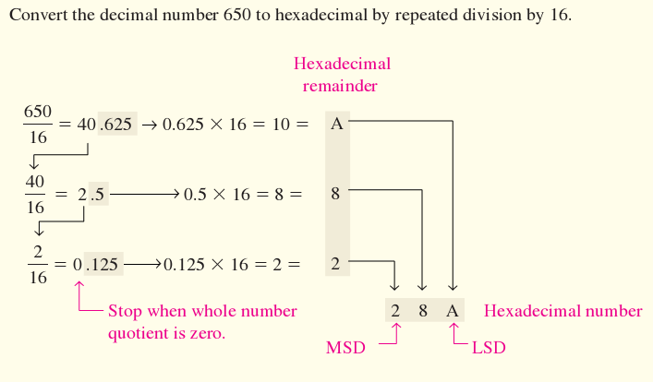

Slide 50
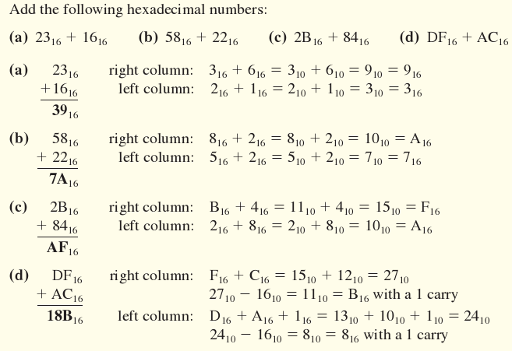

Slide 51

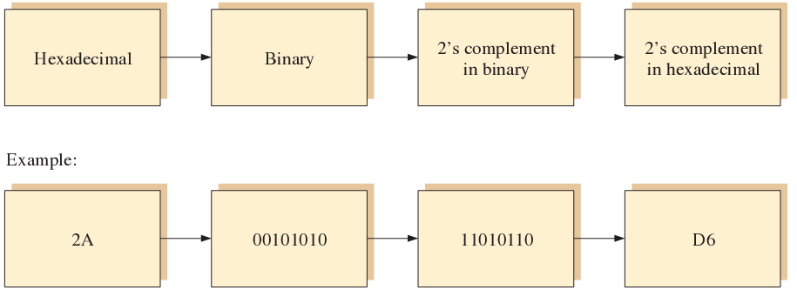
2.8.7 Hexadecimal Subtraction
(十六进制数的减法)

Slide 52
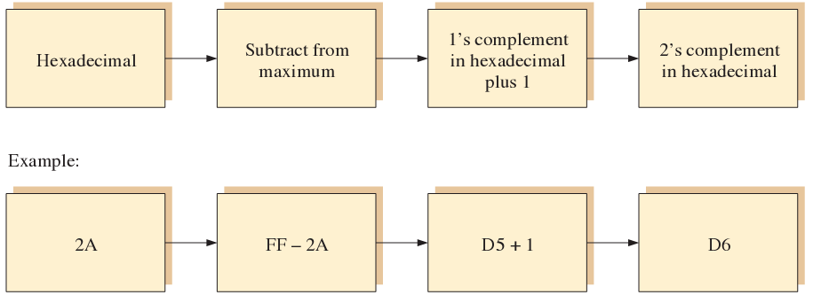

Slide 53
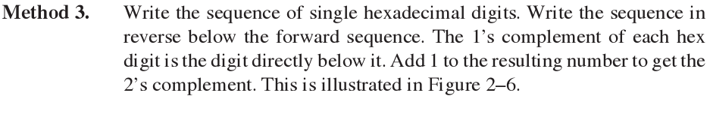
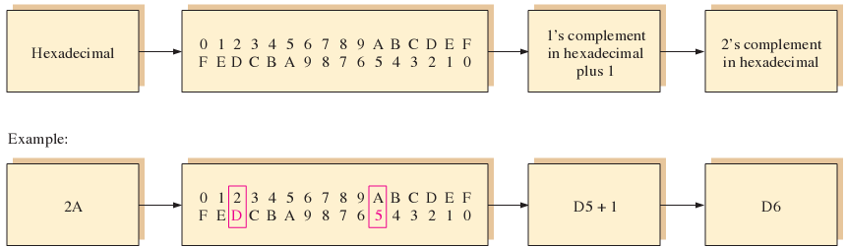

Slide 54


Slide 55



Slide 56

2.9 Octal Numbers (八进制数)

Slide 57

Octal-to-Decimal Conversion

Slide 58

Decimal-to-Octal Conversion

Slide 59



Slide 60

Binary-to-Octal Conversion

Slide 61


Slide 62

2.10 Binary Coded Decimal (BCD)

Slide 63


Slide 64


Slide 65




Slide 66


Slide 67


Slide 68

2.11 Digital Codes (数字编码)
The Gray Code(格雷码)
格雷码是无权码，也不是算术编码
从一个编码字到下一个接续编码字仅有一位发生
变化

Slide 69


An Application
(a) Binary
(b) Gray

Slide 70


Binary-to-Gray Code Conversion

Slide 71


Gray-to-Binary Code Conversion

Slide 72


